Slide 1




Paper ID: 838 , Paper Title: Desktop Voice Assistant: Leveraging the Current State-of-the-Art in Speech Processing
11TH International Conference on Reliability, Infocom Technologies and Optimization (ICRITO’2024)
(Trends and Future Directions)
Presented by: Rishika Gupta
Full Affiliation: KIET Group of Institutions affiliated by Dr. A.P.J Abdul Kalam Technical University , Lucknow
Presentation Date:15 March 2024
14-15 March, 2024
Amity University Uttar Pradesh, Sector – 125, Noida, Delhi NCR

Slide 2
Table of Contents
Abstract
Introduction
Literature Review
Methodology
Result Analysis
Findings and Limitations
Conclusion and Future Scope
References

Slide 3
Abstract
Virtual voice assistants revolutionize human-computer interaction, particularly on mobile devices.
The study focuses on leveraging speech processing technologies to develop a virtual voice assistant for desktop users.
It explores advancements in speech recognition, natural language processing, and dialogue control.
Key considerations include accuracy in silent environments, integration with existing desktop workflows, and customizable user experiences.
The study evaluates potential benefits and challenges of this approach and suggests avenues for future research, aiming to seamlessly connect mobile and desktop voice assistants for efficient computer control via voice commands.

Slide 4
Introduction
Artificial intelligence, particularly voice assistants, simplifies daily tasks by allowing users to interact with devices using natural language.
Voice assistants recognize and execute spoken instructions, enhancing user productivity and providing access to information from the internet.
Virtual assistants like Siri and Google Assistant have become integral parts of smartphones, offering entertainment and functionality.
Python programming language enables the creation of customized virtual assistants with essential features, leveraging libraries and modules for development.
With advancements in artificial intelligence, virtual assistants are becoming smarter and more precise, aiming to serve as personal assistants for users, as demonstrated by the ZEN virtual assistant project designed for Windows-based platforms, which simplifies tasks and saves time for users by enabling voice-operated PCs or laptops.

Slide 5
Literature review
D. Lahiri: Smart Personal Digital Assistant applications are becoming increasingly prevalent across various device platforms, offering enhanced features compared to traditional PDAs.
Voice assistants are deemed more reliable and information-rich than human assistants, as they are portable and internet-connected.
A. Valera Roman: Advances in voice assistant technology suggest an expansion of capabilities beyond basic tasks into more complex domains such as space exploration and medical procedures, driving the need for ongoing artificial intelligence education.
P. Cheng and U. Roedig:Researchers have proposed solutions leveraging virtual voice assistants for various applications, such as tracking daily physical activity for the elderly and assisting with campus information retrieval.
M. Malik:Studies focus on improving voice recognition methods through deep learning techniques, including feature extraction and model optimization, to enhance accuracy and efficiency in voice applications.

Slide 6
Literature review
M.Alam:Deep learning methods, particularly recurrent neural network (RNN) models, dominate voice recognition systems, especially in natural language processing (NLP) applications.
A. B. Nassif: Hybrid deep neural network (DNN) models, combining DNNs with hidden Markov models (HMMs), are favoured due to their superior performance over standalone models.
Z. Song:Various techniques, such as convolutional neural networks (CNNs) and restricted Boltzmann machines (RBMs), are employed to improve voice recognition accuracy by extracting acoustic features and speech attributes.
P. Bell:Meta-analyses indicate that adaptation techniques are effective for both hybrid and end-to-end (E2E) voice recognition systems across different datasets and classes.
J. Fainberg:Challenges remain in unsupervised and semi-supervised E2E system training, particularly in utilizing uncertainty propagation techniques.

Slide 7
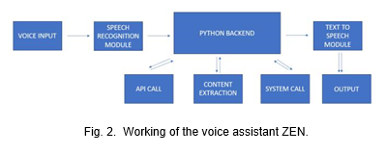
Methodology
Speech Recognition Module: Utilizes a Python module for converting speech to text, enabling voice commands to be recognized and processed.
Python Backend: Receives the output from the speech recognition module and determines the appropriate action, whether it's a system call, API call, or content extraction.
API Calls: Facilitates communication between ZEN and external applications, allowing user requests to be transmitted and results to be returned.
Content Extraction: Involves extracting organized information from unstructured or semi-structured sources, primarily using natural language processing (NLP) techniques.
System Call: Enables ZEN to request services from the operating system's kernel while it's running, allowing for seamless interaction with system resources.
Text-to-Speech Module: Converts text generated by ZEN into spoken words, enabling the assistant to provide auditory feedback to the user.

Slide 8
Methodology
Pywhatkit. Utilizing this library is an absolute breeze, as it is designed to simplify any interaction with the browser.
Speech Recognition Library: Foundation of the project, used to identify human speech and translate it from input voice to text.
Pyttsx3 Module: Offline module for text-to-speech conversion, offering functions for controlling the timing of speech output.
Wikipedia Integration: Utilizes the Wikipedia Python library to manage Wikipedia requests and provide answers to user queries.
OS and Web Browser Libraries: Enables ZEN to perform various operating system tasks and interact with the default web browser, expanding its functionality and utility.

Slide 9
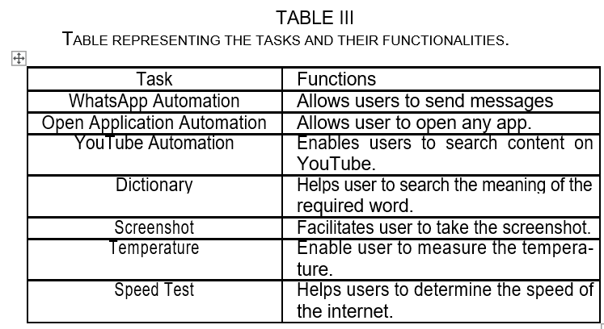
Result Analysis
When we start up the assistant ZEN it greets the user by saying “Hello Sir I am ZEN. How may I help you?”. And it waits for the user to command tasks. Following are the tasks that ZEN can perform when the user commands it

Slide 10
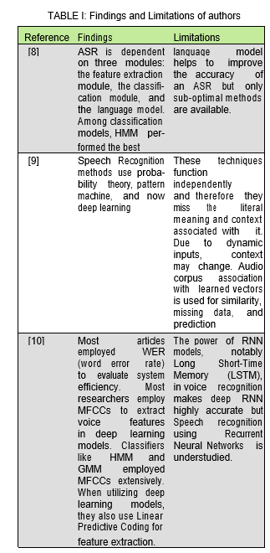
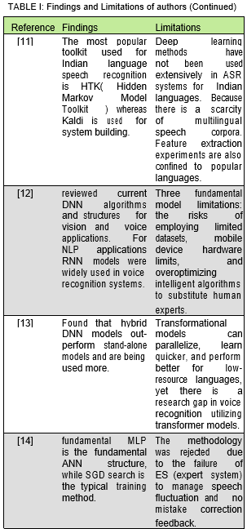
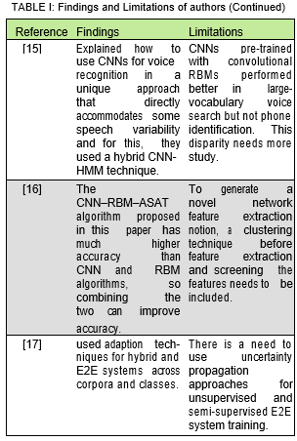
Table of Findings

Slide 11

Virtual Assistants on desktops offer a highly efficient means of organizing schedules and executing various tasks, assisting users in managing their time effectively.
Python voice assistants, akin to Alexa, Siri, or Google Assistant, can be developed to work seamlessly across all Windows versions, enhancing user accessibility and functionality.
Voice assistants simplify user interactions and perform routine tasks upon request, catering to various sectors such as daily usage and home appliances.
They provide accessibility to information for illiterate individuals through natural language conversation, thereby increasing their utility and inclusivity.
Integration of voice assistants into daily life has surged, automating tasks like sending messages, browsing the web, and conducting searches, contributing to increased user convenience and productivity.
Leveraging Artificial Intelligence and Python, projects like ZEN aim to develop desktop assistants capable of handling automated tasks, demonstrating the ongoing evolution and innovation in voice assistant technology.
Conclusion and future scope

Slide 12

Conclusion and future scope
Voice assistants exhibit significant progress and hold great potential in various fields such as smart homes, customer service, healthcare, and education, offering convenience and efficiency to users.
As voice assistant technology continues to advance rapidly, they are poised to become indispensable tools in everyday life, enhancing productivity and accessibility across different domains.
The increasing integration of voice assistants into various sectors underscores their future importance, with the potential to revolutionize how we interact with technology and accomplish tasks, ultimately becoming an integral part of modern living.

Slide 13

References
D. Lahiri, P. C. P. Kandimalla, and A. Jeysekar, “Hybrid multi-purpose voice assistant,” in 2023 2nd International Conference on Applied Artificial Intelligence and Computing (ICAAIC). IEEE, 2023, pp. 816– 822.
I. Shazhaev, D. Mikhaylov, A. Shafeeg, A. Tularov, and I. Shazhaev, “Personal voice assistant: from inception to everyday application,” Indonesian Journal of Data and Science, vol. 4, no. 2, pp. 64–70, 2023.´
A. Valera Roman,´ D. Pato Mart´ınez, A. Lozano Murciego, D. M. Jimenez´-Bravo, and J. F. de Paz, “Voice assistant application for avoiding sedentarism in elderly people based on iot technologies,” Electronics, vol. 10, no. 8, p. 980, 2021.
P.-S. Chiu, J.-W. Chang, M.-C. Lee, C.-H. Chen, and D.-S. Lee, “Enabling intelligent environment by the design of emotionally aware virtual assistant: A case of smart campus,” IEEE Access, vol. 8, pp. 62 032–62 041, 2020.
P. Cheng and U. Roedig, “Personal voice assistant security and pri-vacy—a survey,” Proceedings of the IEEE, vol. 110, no. 4, pp. 476–507, 2022.
F. Elghaish, J. K. Chauhan, S. Matarneh, F. P. Rahimian, and M. R. Hosseini, “Artificial intelligence-based voice assistant for bim data management,” Automation in Construction, vol. 140, p. 104320, 2022.
A. Poushneh, “Humanizing voice assistant: The impact of voice assistant personality on consumers’ attitudes and behaviors,” Journal of Retailing and Consumer Services, vol. 58, p. 102283, 2021.
M. Malik, M. K. Malik, K. Mehmood, and I. Makhdoom, “Automatic speech recognition: a survey,” Multimedia Tools and Applications, vol. 80, pp. 9411–9457, 2021.
S. Raju, V. Jagtap, P. Kulkarni, M. Ravikanth, and M. Rafeeq, “Speech recognition to build context: A survey,” in 2020 international conference on computer science, engineering and applications (ICCSEA). IEEE, 2020, pp. 1–7.

Slide 14
References
A. B. Nassif, I. Shahin, I. Attili, M. Azzeh, and K. Shaalan, “Speech recognition using deep neural networks: A systematic review,” IEEE access, vol. 7, pp. 19 143–19 165, 2019.
A. Singh, V. Kadyan, M. Kumar, and N. Bassan, “Asroil: a compre-hensive survey for automatic speech recognition of indian languages,” Artificial Intelligence Review, vol. 53, pp. 3673–3704, 2020.
M. Alam, M. D. Samad, L. Vidyaratne, A. Glandon, and K. M. Iftekharuddin, “Survey on deep neural networks in speech and vision systems,” Neurocomputing, vol. 417, pp. 302–321, 2020.
D. Al-Fraihat, Y. Sharrab, F. Alzyoud, A. Qahmash, M. Tarawneh, and A. Maaita, “Speech recognition utilizing deep learning: A systematic review of the latest developments,” HUMAN-CENTRIC COMPUTING AND INFORMATION SCIENCES, vol. 14, 2024.
D. O’Shaughnessy, “Trends and developments in automatic speech recognition research,” Comput. Speech Lang., vol. 83, no. C, jan 2024. [Online]. Available: https://doi.org/10.1016/j.csl.2023.101538
O. Abdel-Hamid, A.-r. Mohamed, H. Jiang, L. Deng, G. Penn, and D. Yu, “Convolutional neural networks for speech recognition,” IEEE/ACM Transactions on audio, speech, and language processing, vol. 22, no. 10, pp. 1533–1545, 2014.
Z. Song, “English speech recognition based on deep learning with multiple features,” Computing, vol. 102, no. 3, pp. 663–682, 2020.
P. Bell, J. Fainberg, O. Klejch, J. Li, S. Renals, and P. Swietojanski, “Adaptation algorithms for neural network-based speech recognition: An overview,” IEEE Open Journal of Signal Processing, vol. 2, pp. 33–66, 2020.

Slide 15
Thank you

